Slide 1
MySQL INTERNSHIP
Task 1 : HR Data Analytics

Slide 2

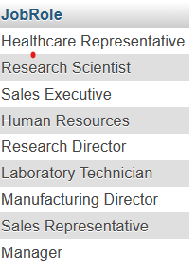
Retrieve the total number of employees in the dataset.
select count(EmployeeID) from general_data;
2. List all unique job roles in the dataset.
select distinct(JobRole) from general_data;

Slide 3

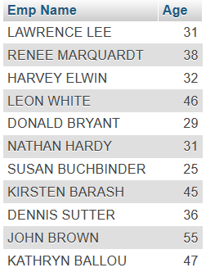
3. Find the average age of employees.
select floor(avg(Age)) as avg_age from general_data;
4. Retrieve the names and ages of employees who have worked at the company for more
than 5 years.
select `Emp Name`, Age from general_data where TotalWorkingYears > 5;

Slide 4
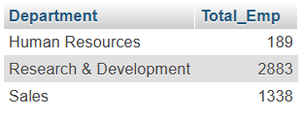
5. Get a count of employees grouped by their department.
select Department, count(EmployeeID) as Total_Emp from general_data
group by Department;

Slide 5
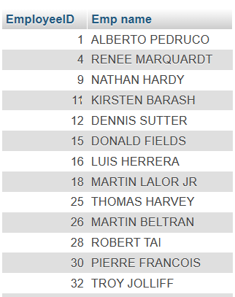
6. List employees who have 'High' Job Satisfaction.
select g.EmployeeID ,g.`Emp name` from general_data g inner join employee_survey_data esd on g.EmployeeID= esd.EmployeeID and
esd.JobSatisfaction =(select max(JobSatisfaction) from employee_survey_data);

Slide 6

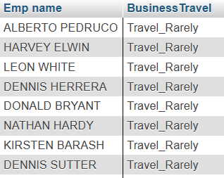
7. Find the highest Monthly Income in the dataset.
select `Emp name`,max(MonthlyIncome) from general_data;
8. List employees who have 'Travel_Rarely' as their BusinessTravel type.
select `Emp name`, BusinessTravel from general_data where BusinessTravel ='Travel_Rarely';

Slide 7
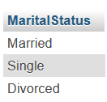
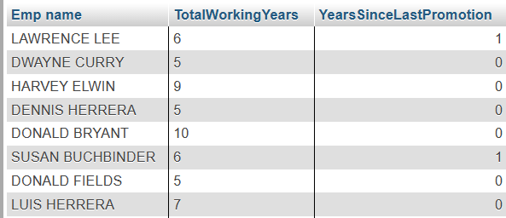
9. Retrieve the distinct MaritalStatus categories in the dataset.
select distinct(MaritalStatus) from general_data;
10. Get a list of employees with more than 2 years of work experience but less than 4 years in their current role?
select `Emp name`,TotalWorkingYears,YearsSinceLastPromotion from general_data where TotalWorkingYears > 2 and YearsSinceLastPromotion < 4;

Slide 8
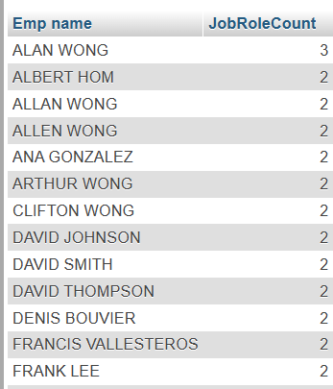
11. List employees who have changed their job roles within the company (JobLevel and JobRole differ from their previous job).
select `Emp name`,Count(JobRole) As JobRoleCount from general_data group by `Emp name` Having JobRoleCount >1;

Slide 9
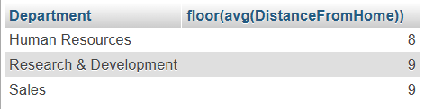
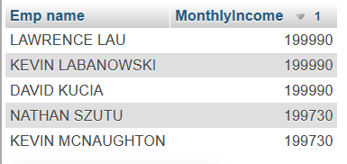
12. Find the average distance from home for employees in each department.
select Department,floor(avg(DistanceFromHome)) from general_data
group by Department;
13. Retrieve the top 5 employees with the highest MonthlyIncome.
select `Emp name`,MonthlyIncome from general_data order by MonthlyIncome
desc limit 5;

Slide 10

14. Calculate the percentage of employees who have had a promotion in the last year.
select concat(cast(count(gd.EmployeeID)/(select count(gd1.EmployeeID)
from general_data gd1) * 100 as decimal(4,2)), '%') as Percentage
from general_data gd where gd.YearsSinceLastPromotion = 1;

Slide 11
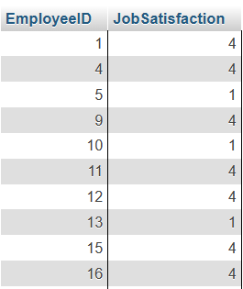
15. List the employees with the highest and lowest EnvironmentSatisfaction.
select EmployeeID,JobSatisfaction from `employee_survey_data`
where JobSatisfaction in(1,4);

Slide 12
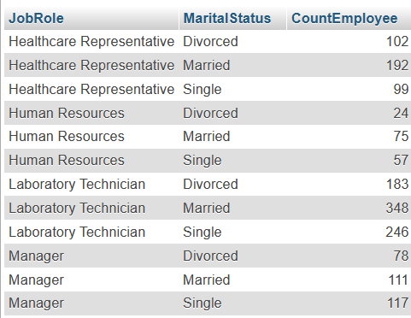
16. Find the employees who have the same JobRole and MaritalStatus
select JobRole,MaritalStatus,count(*) As CountEmployee from general_data group by JobRole,MaritalStatus Having count(*) >1;

Slide 13
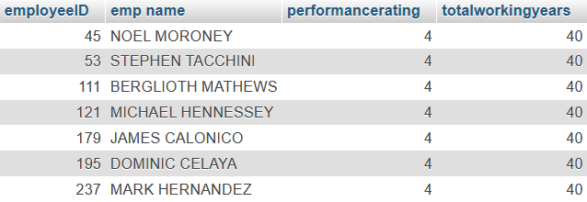
17. List the employees with the highest TotalWorkingYears who also have a
PerformanceRating of 4.
select gd.employeeID, gd.`emp name`, msd.performancerating, gd.totalworkingyears from general_data gd inner join manager_survey_data msd on gd.employeeID = msd.employeeID and msd.performancerating = 4 and gd.totalworkingyears = (select max(gd1.totalworkingyears) from general_data gd1)

Slide 14
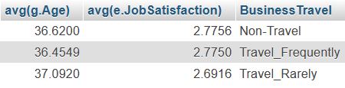
18. Calculate the average Age and JobSatisfaction for each BusinessTravel type.
select g.EmployeeID, avg(g.Age),avg(e.JobSatisfaction),g.BusinessTravel from general_data g inner join employee_survey_data e on g.EmployeeID=e.EmployeeID group by BusinessTravel;

Slide 15

19. Retrieve the most common EducationField among employees.
select EducationField, count(EducationField) As CommonCount from general_data group by EducationField order by CommonCount desc limit 1 ;

Slide 16
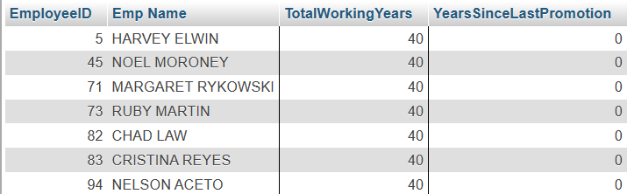
20. List the employees who have worked for the company the longest but haven't had a
promotion.
select EmployeeID,`Emp Name`, TotalWorkingYears ,YearsSinceLastPromotion from general_data where YearsSinceLastPromotion=0 and
TotalWorkingYears= (select(max(TotalWorkingYears)) from general_data);

Slide 17
Thank You

